Slide 1
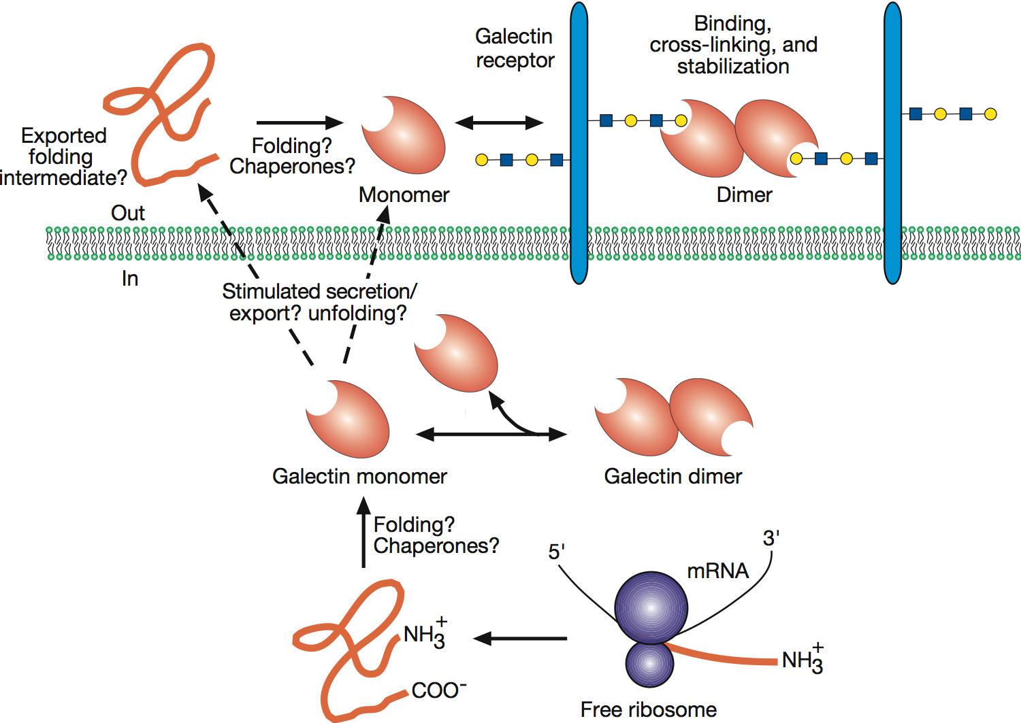


Functional interactions of galectins with cell-surface and extracellular glycoconjugates
Essentials of Glycobiology
Chapter 33, Figure 4
Second Edition
Notes:
FIGURE 33.4. Functional interactions of galectins with cell-surface glycoconjugates and extracellular glycoconjugates can lead to cell adhesion and cell signaling. Interactions of galectins with intracellular ligands may also contribute to the regulation of intracellular pathways.

